Slide 1

SESHADRI RAO GUDLAVALLERU ENGINEERING COLLEGE
Department of Computer Science and Engineering
MAIN PROJECT
On
Analysis of Behavioral Characteristics of Jammers to Detect Malicious Nodes in Mobile ADHOC Networks.
By
19481A05M9 – S. B. Mukesh
19481A05N3 – Thabassum
20485A0523 – V. Mohan Sai
19481A05O6 – V. Manoj
Under the Guidance of
Dr. Adilakshmi Yanam

Slide 2

Introduction – MANETs
The first question that comes to mind “What does MANETS mean?”
A Mobile ADHOC Network (MANET) is a self-configuring network of mobile devices connected by wireless links, without the use of a centralized infrastructure or administration.
In a MANET, each device functions as a router, forwarding data to other devices within the network. The nodes in a MANET are free to move independently in any direction, and the network topology may change rapidly and unpredictably over time.

Slide 3
Properties of MANETs
Dynamic Topology
Limited Resources
Peer-to-Peer Communication
Autonomous Operation
Limited Bandwidth
Security Challenges
Scalability Issues

Slide 4
Research Challenges in MANETs
Security
Resource utilization
Routing
Energy efficiency
Quality of Service (QoS)
Scalability
Interference and congestion
Mobility
Heterogeneity
Data management
Integration with other networks

Slide 5
How does Routing is performed in MANETs
Routing in Mobile Ad-hoc Networks (MANETs) is the process of finding a path from a source node to a destination node in a dynamic and decentralized network.
There are two main types of routing protocols in MANETs. They are:
Proactive Routing Protocols
Distance-Vector Routing Protocols
Link-State Routing Protocols
Reactive routing protocols
Destination-Sequenced Distance-Vector (DSDV)
Ad Hoc On-demand Distance Vector (AODV)

Slide 6
Types of attacks observed in MANETs
Blackhole attack
Wormhole attack
Rushing attack
Sybil attack
Denial-of-service (DoS) attack
Eavesdropping attack
Impersonation attack

Slide 7
ABSTRACT
Wireless ADHOC Networks are used to establish a wireless connection between two computing devices without the need for a Wi-Fi access point or router. This network is decentralized and uses omnidirectional communication media, which makes it more vulnerable to certain types of attacks compared to wired networks. Jamming attacks, a subset of denial-of-service (DoS) attacks, involve malicious nodes that intentionally interfere with the network, blocking legitimate communication. To address this issue, the proposed method analyzes various characteristics of nodes, such as packets sent, received, and dropped, at each node. Using the packet delivery ratio and packet drop ratio, the method detects jamming nodes from normal nodes, improving network performance. The network is simulated in NS2 environment.

Slide 8
Objectives of this project
The objectives of jamming attacks in networking are to disrupt communication between devices by overwhelming the targeted network with noise or false signals, making it difficult or impossible for legitimate signals to get through.
The main objective of this project is to analyze the behavioral characteristics of various so that unauthorized access can be detected.
By analyzing the characteristics of jamming attacks, the network operations are protected, and the services of network availability and confidentiality are also projected.

Slide 9
Related Work
Previously, Cheng et al offer a comprehensive study of the jammer localization problem, and propose a simple yet effective algorithm called Double Circle Localization (DCL). They assume all nodes in the network
Are deployed randomly
Are static
Have the same capability (e.g. transmission power, signal sensitivity);
Know their own location
Can recognize whether they are jammed.
They consider a single-jammer scenario, and apply the free-space propagation model, according to which jamming signals attenuate with distance, and reduce to the normal ambient noise level on a circle centered at the jammer. The proposed algorithm calculates the mini- mum bounding circle and the maximum inscribed circle of the convex hull of the set of jammed nodes, and combines their centers to estimate the location of the jammer.

Slide 10
Methodology
Jamming attacks can have serious consequences on mobile ad hoc networks (MANETs) and other wireless networks.
Firstly, jamming attacks can disrupt the communication between legitimate nodes and prevent them from exchanging data, which can result in the loss of critical information.
Secondly, jamming attacks can drain the battery of nodes in the network, as they are forced to retransmit their messages multiple times due to the interference caused by the jammer.
Thirdly, jamming attacks can make it easier for an attacker to launch other types of attacks, such as impersonation or interception attacks, as the communication between nodes is compromised.
Finally, jamming attacks are difficult to detect and mitigate, as they can be launched from a distance and do not require physical access to the network.
These reasons highlight the importance of focusing on jamming attacks and developing effective countermeasures to detect and prevent them in wireless networks.

Slide 11
Constant Jamming Attack
A constant jamming attack is a type of jamming attack in which a malicious node continuously transmits a high-power signal, effectively blocking all communication within the network.
This type of attack can be particularly dangerous because it can go undetected for long periods of time and can cause significant disruption to the network.
The malicious node may be able to selectively jam specific parts of the network, allowing it to eavesdrop on certain communications while blocking others.
Additionally, the constant transmission of high-power signals can drain the batteries of neighbouring nodes, leading to a degradation in network performance and potentially causing some nodes to fail altogether.

Slide 12
Periodic Jamming Attack
A periodic jammer disrupts wireless communication by generating jamming signals, in which the duration of the period of inactivity that occurs between consecutive transmissions follows the jamming rate R specifies an exponential distribution.
Periodic jamming attacks are particularly effective in disrupting the communication in mobile ad hoc networks (MANETs), as these networks rely on wireless communication and do not have a fixed infrastructure.
The periodic jamming signals can cause nodes in the network to lose synchronization and lead to a breakdown in the routing protocols used to manage communication in the network.

Slide 13
Random Jamming Attack
Random jamming attacks are a type of wireless jamming attack that disrupts the communication in a wireless network by transmitting radio frequency signals indiscriminately.
In a random jamming attack, the attacker transmits radio signals on the same frequency as the legitimate wireless network, effectively blocking or jamming the communication between nodes in the network.
This type of attack is particularly difficult to defend against, as the attacker does not target specific nodes or transmissions, but instead jams all signals in the affected frequency range.

Slide 14
Detection Procedure
After simulating the network with 10 nodes and different types of attackers with variation in number of attackers, we will be getting the trace files from which we will be extracting the characteristics such as number of packets sent, received and dropped by each node by which we will be able to detect the malicious nodes or not.
Packets Sent
Packet Sent by a node refers to a unit of data that is transmitted between nodes in the network.
Packets Received
Packets Received by a node refers to the number of data packets that have been successfully received by that particular node from other nodes in the network.
Packets Drop
Packets Dropped by a node in a network refer to the number of data packets that are discarded by the node without being forwarded to the next node in the network.

Slide 15
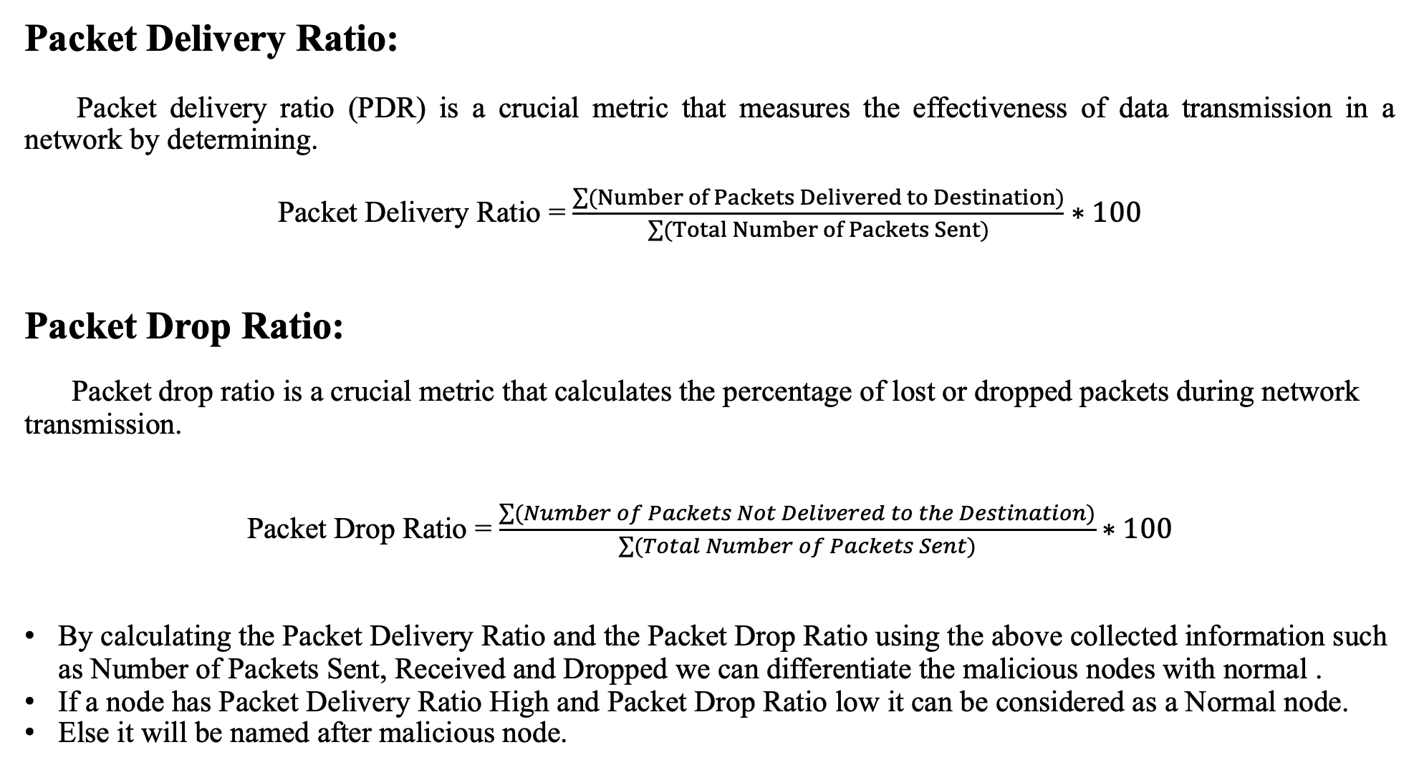
Packet Delivery Ratio:
Packet delivery ratio (PDR) is a crucial metric that measures the effectiveness of data transmission in a network by determining.
Packet Delivery Ratio = $\frac{\sum{(Number of Packets Delivered to Destination)}}{\sum{(Total Number of Packets Sent})}∗100$
Packet Drop Ratio:
Packet drop ratio is a crucial metric that calculates the percentage of lost or dropped packets during network transmission.
Packet Drop Ratio = $\frac{\sum{(Number of Packets Not Delivered to the Destination)}}{\sum{(Total Number of Packets Sent})}∗100$
By calculating the Packet Delivery Ratio and the Packet Drop Ratio using the above collected information such as Number of Packets Sent, Received and Dropped we can differentiate the malicious nodes with normal .
If a node has Packet Delivery Ratio High and Packet Drop Ratio low it can be considered as a Normal node.
Else it will be named after malicious node.

Slide 17
IMPLEMENTATION
Initially, the .tcl file for running the jamming attack is executed by python to iterate the process several times in ns2 environment of ubuntu operating system.
The resulting trace files and nam files are sent as input to a python program to analysis.
Based on the retrieved data, the following graphs have been plotted using Python functionality.

Slide 18
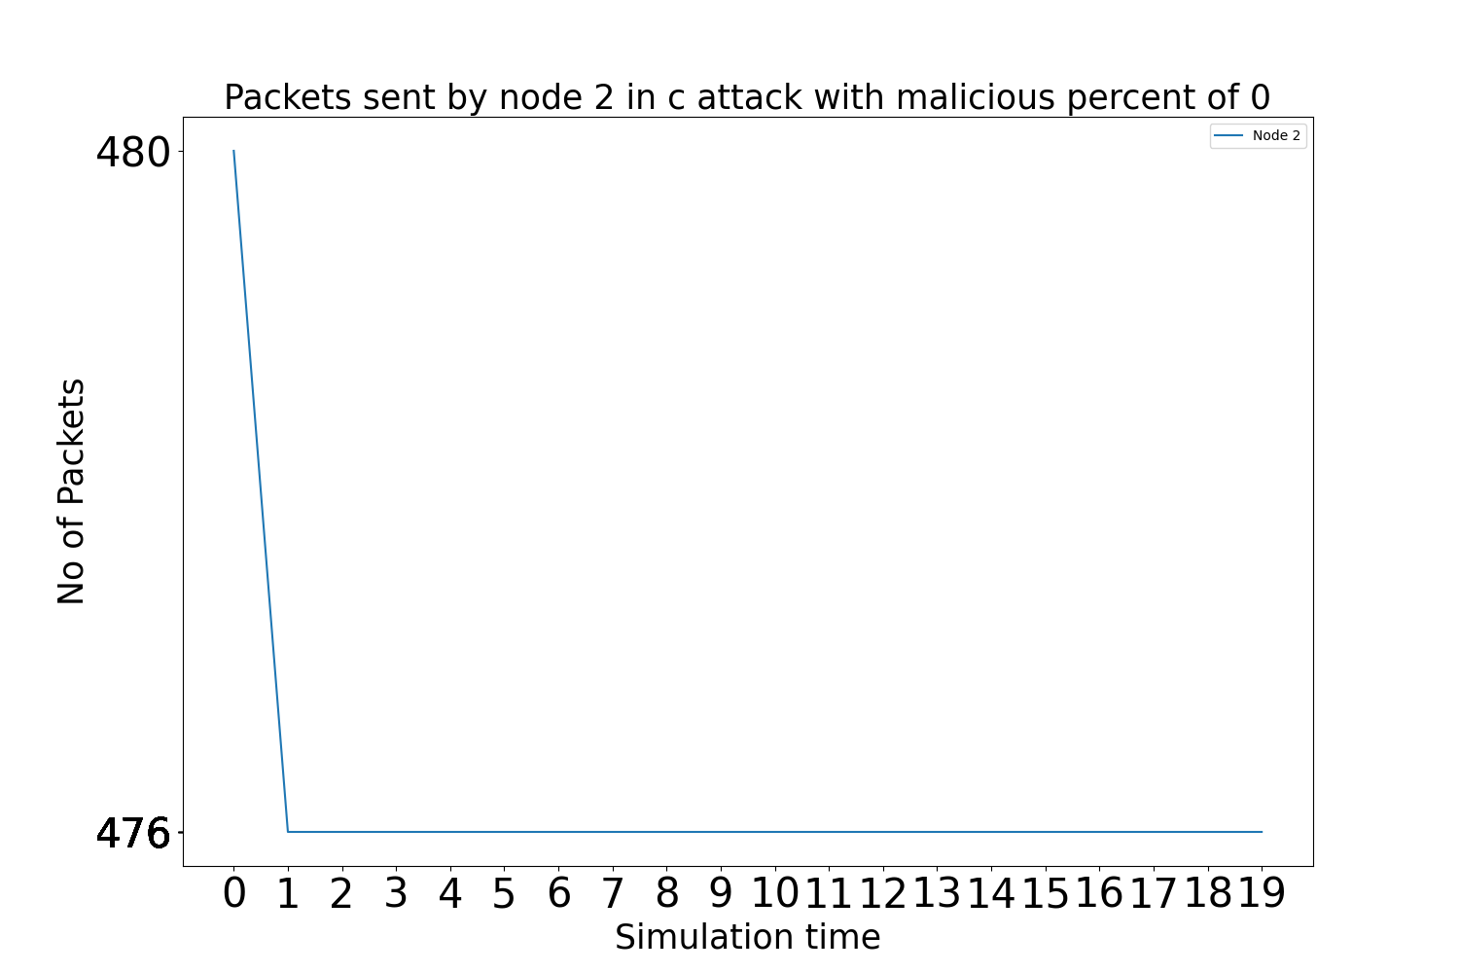
RESULTS
Graphs: Packets Sent by benign node 2 when there are no attackers in Constant attack

Slide 19
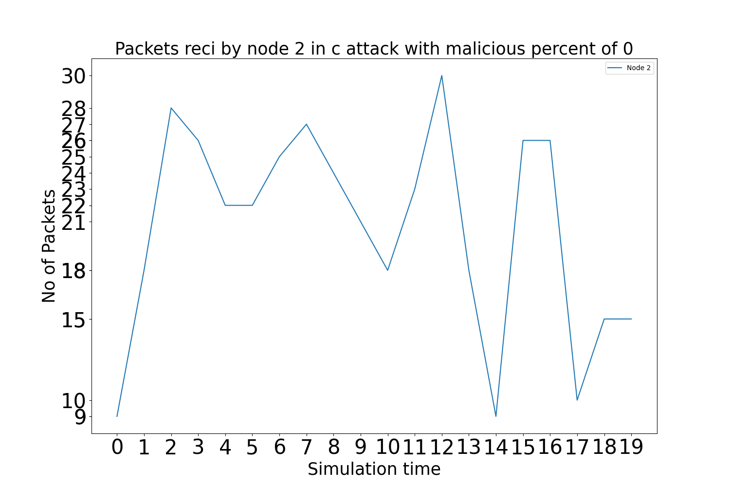
Graphs: Packets Received by benign node 2 when there are no attackers in Constant attack

Slide 20
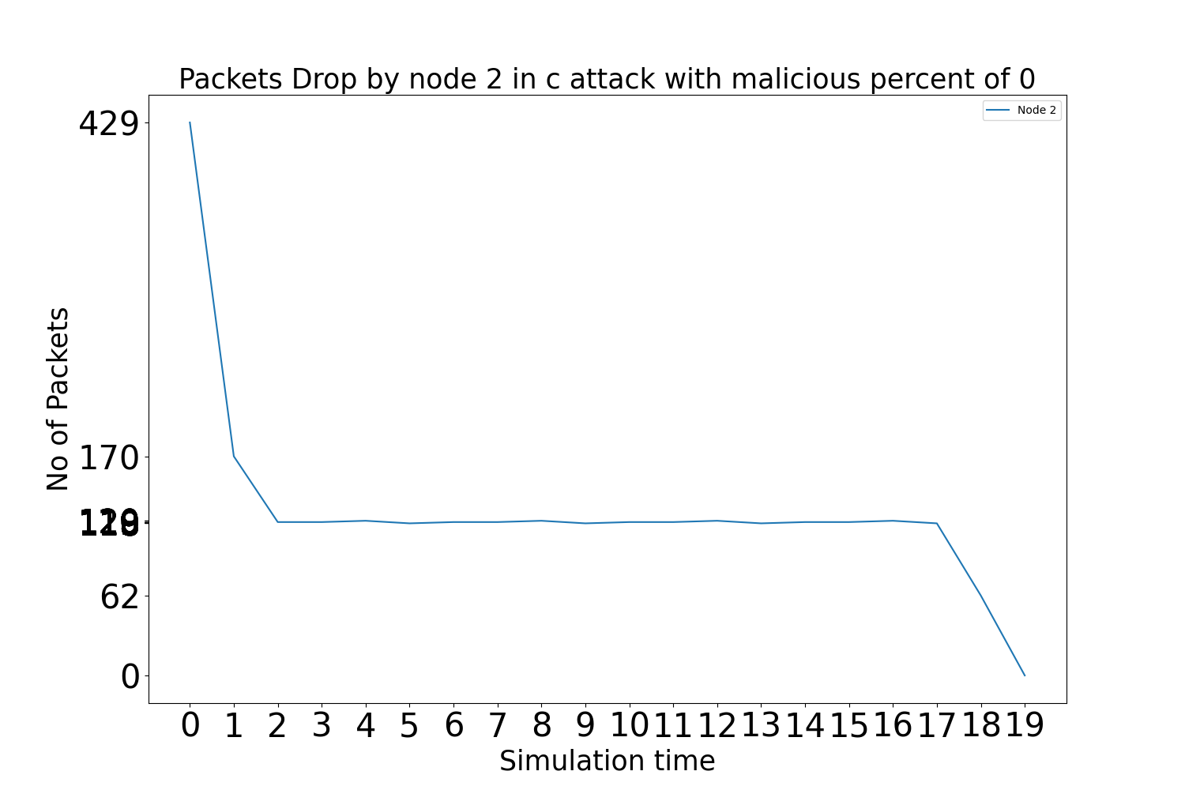
Graphs: Packets Dropped by benign node 2 when there are no attackers in Constant attack

Slide 21

Graphs: Packets Sent by benign node 2 when there are 2 attackers in Constant attack

Slide 22
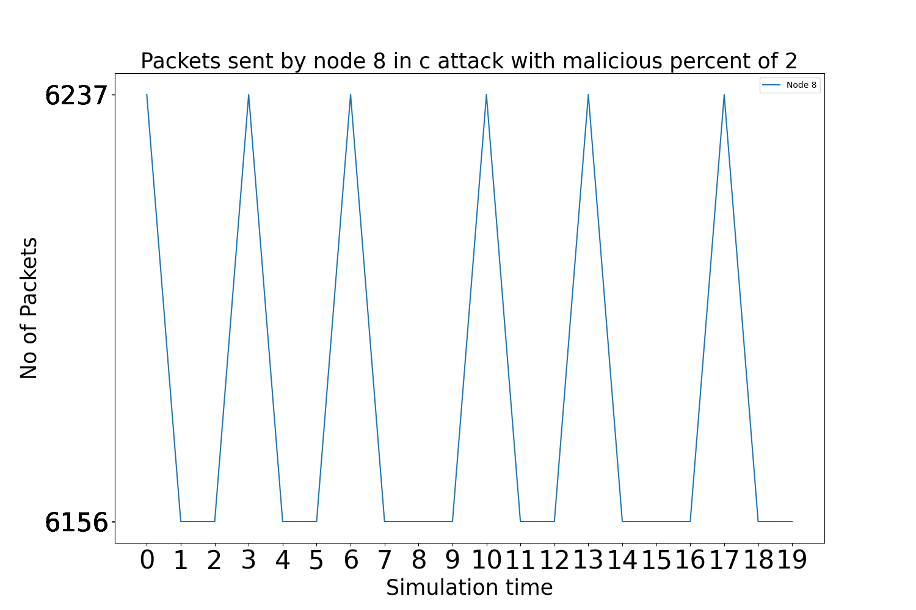
Graphs: Packets Sent by malicious node 8 when there are 2 attackers in Constant attack

Slide 23

Graphs: Packets Sent by malicious node 9 when there are 2 attackers in Constant attack

Slide 24
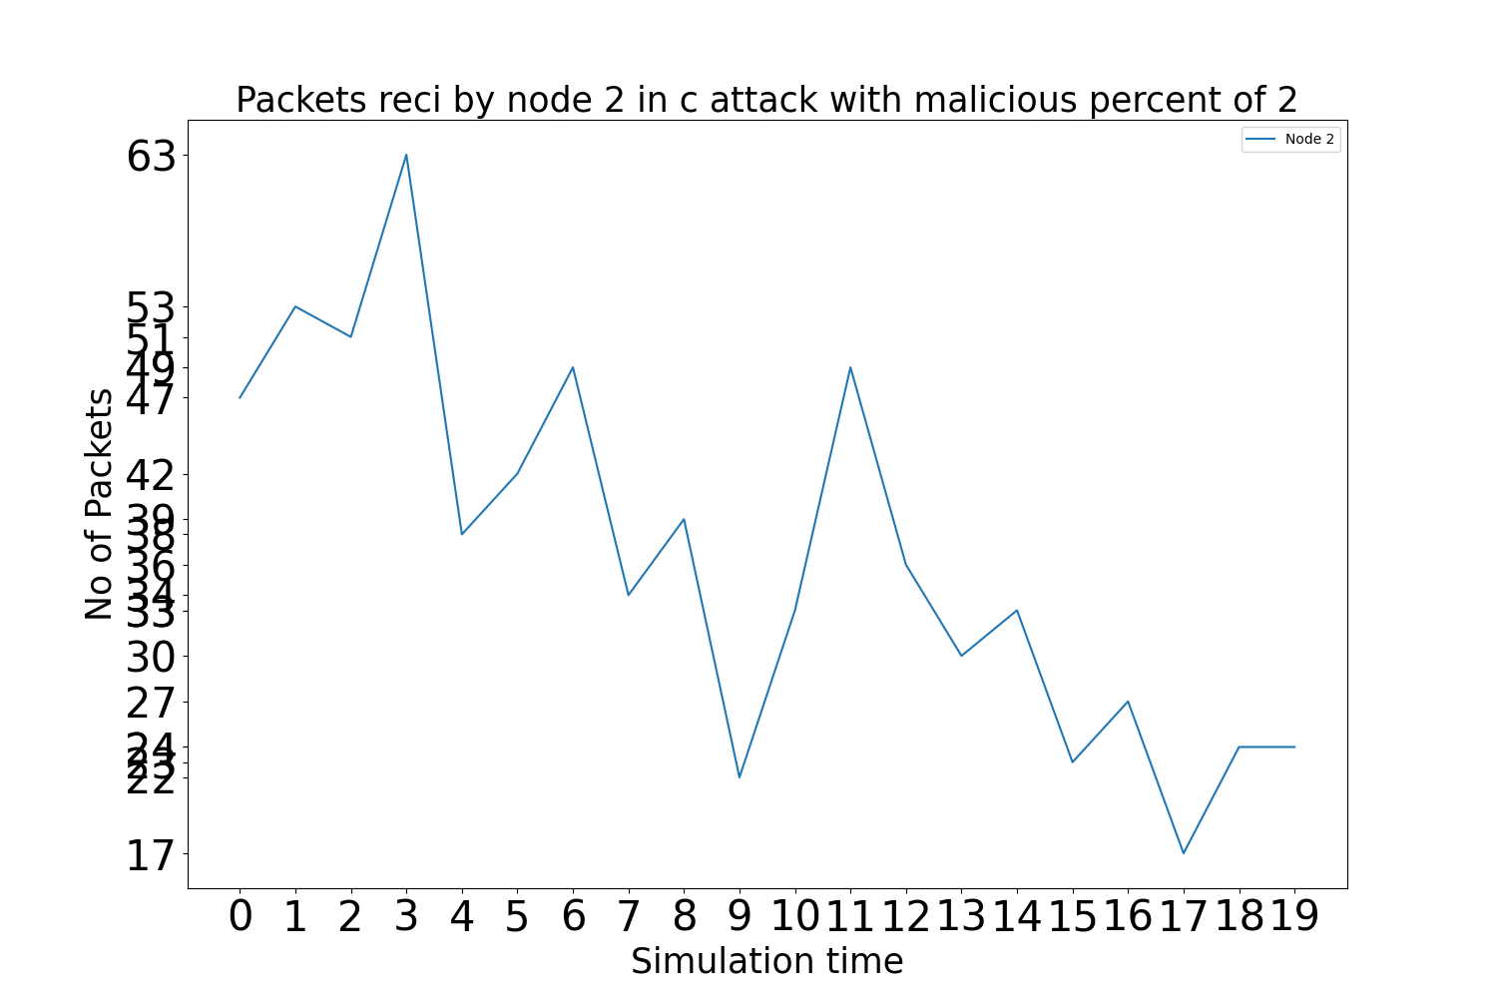
Graphs: Packets Received by benign node 2 when there are 2 attackers in Constant attack

Slide 25
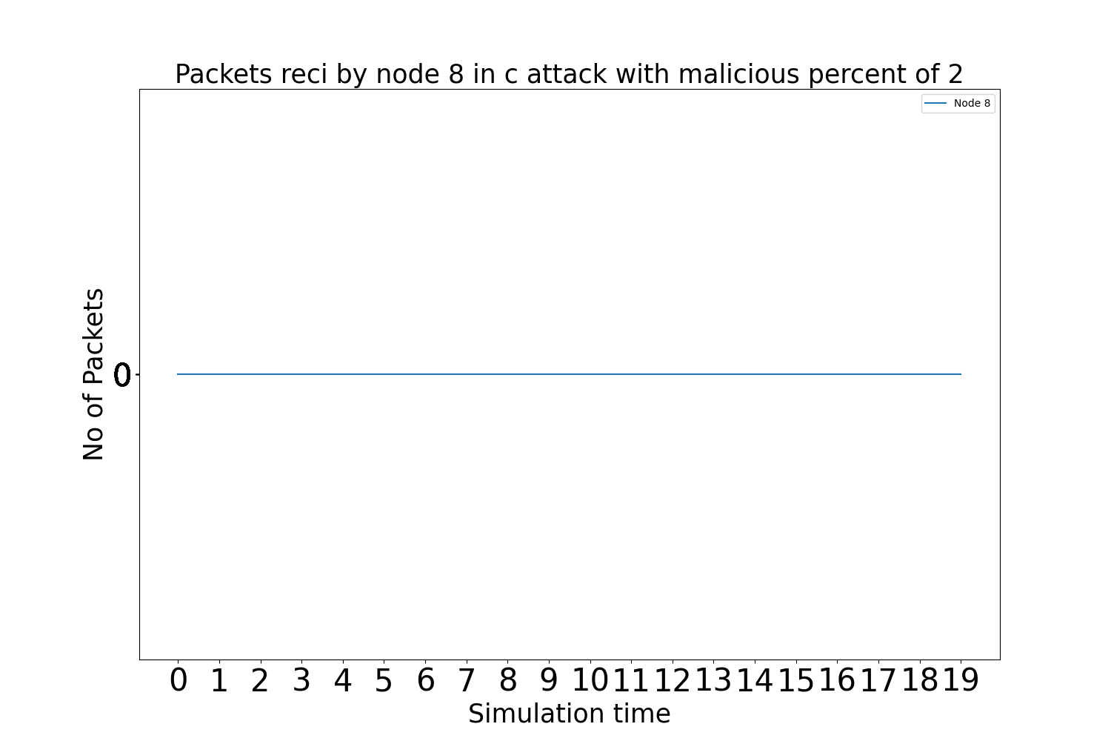
Graphs: Packets Received by malicious node 8 when there are 2 attackers in Constant attack

Slide 26

Graphs: Packets Received by malicious node 9 when there are 2 attackers in Constant attack

Slide 27
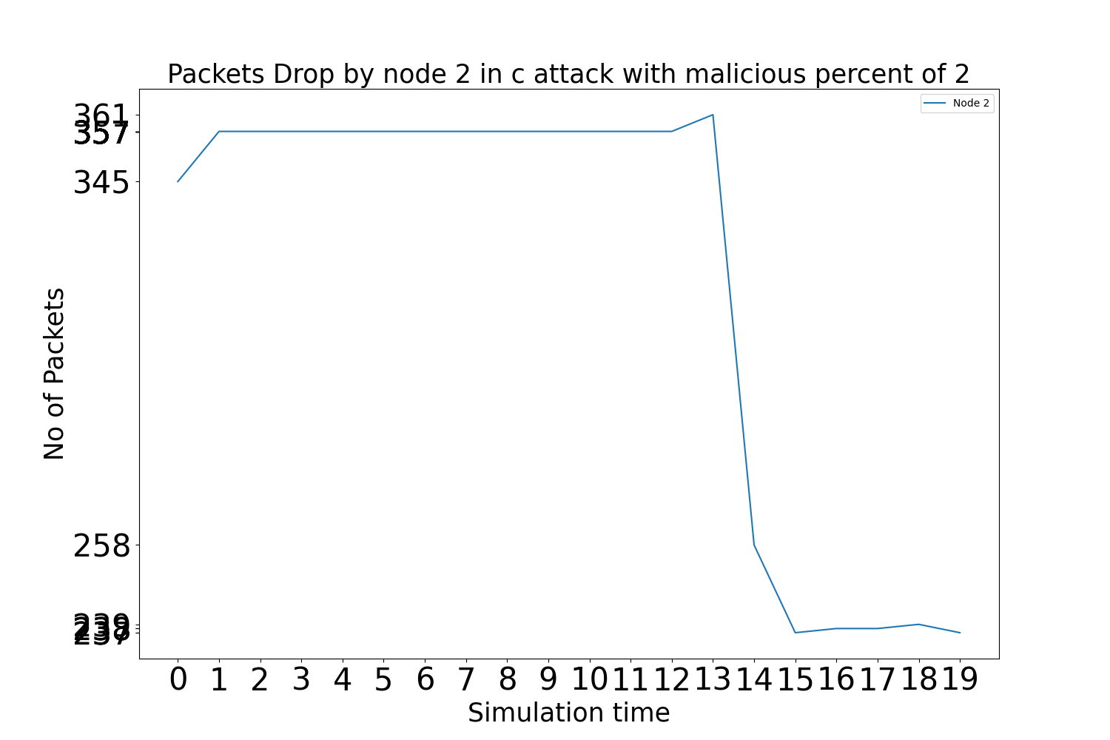
Graphs: Packets Dropped by benign node 2 when there are 2 attackers in Constant attack

Slide 28
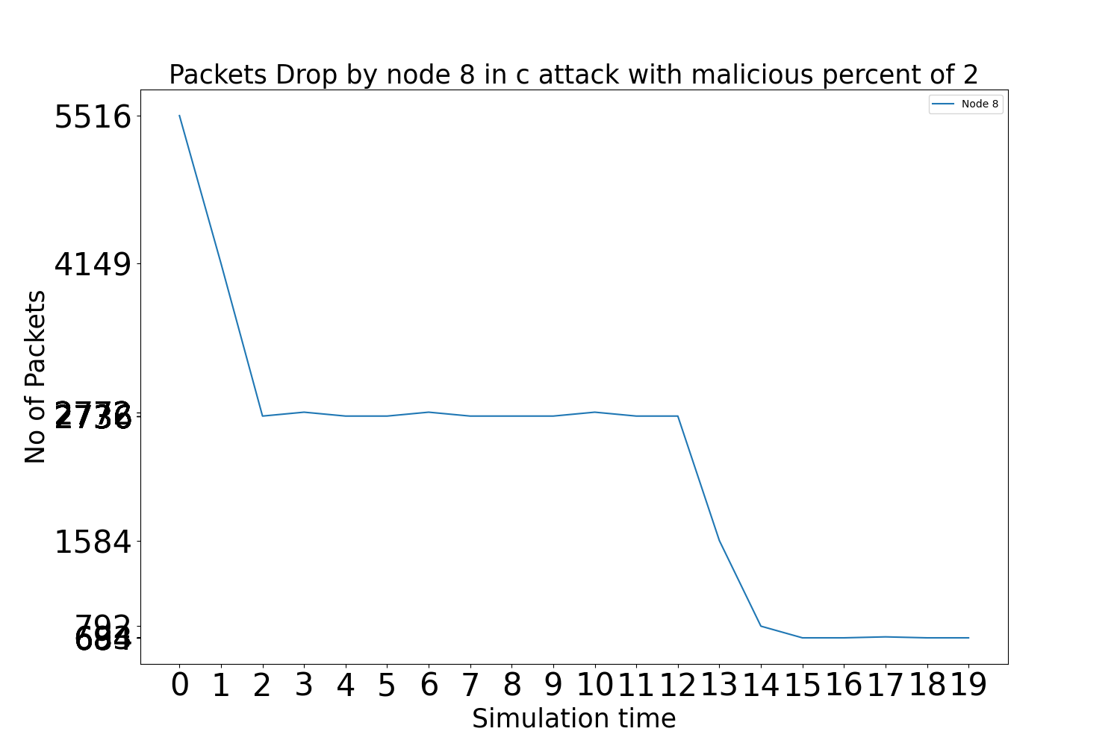
Graphs: Packets Dropped by malicious node 8 when there are 2 attackers in Constant attack

Slide 29
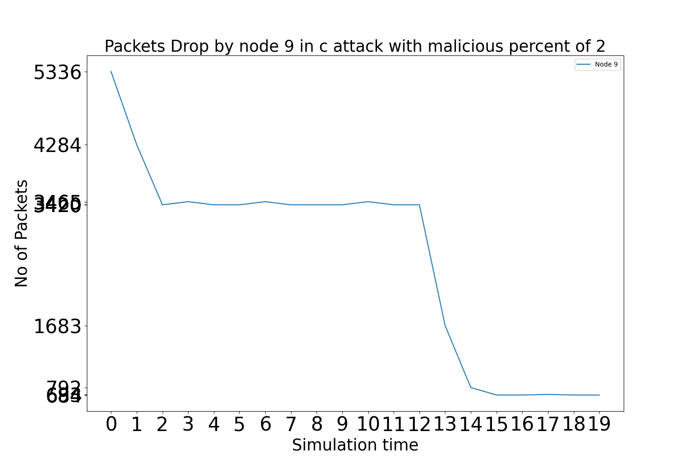
Graphs: Packets Dropped by malicious node 9 when there are 2 attackers in Constant attack

Slide 30

Graphs: Packets Sent by benign node 2 when there are no attackers in Periodic attack

Slide 31
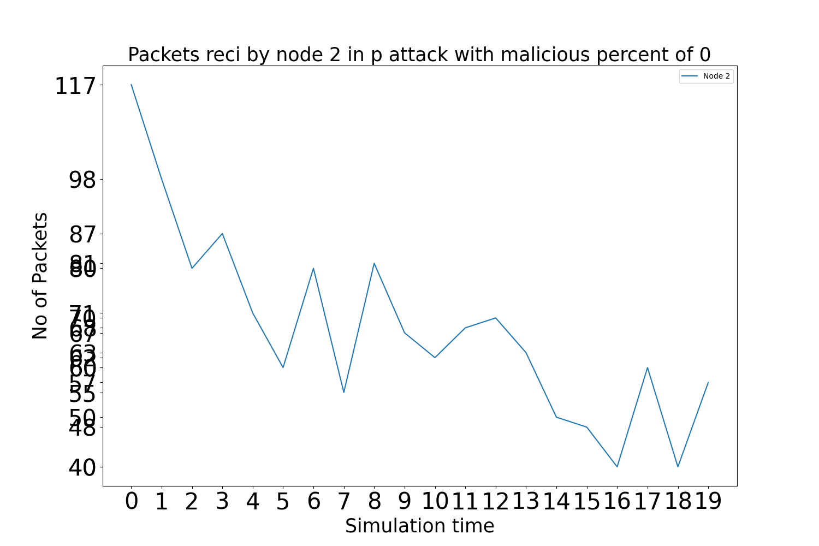
Graphs: Packets Received by benign node 2 when there are no attackers in Periodic attack

Slide 32
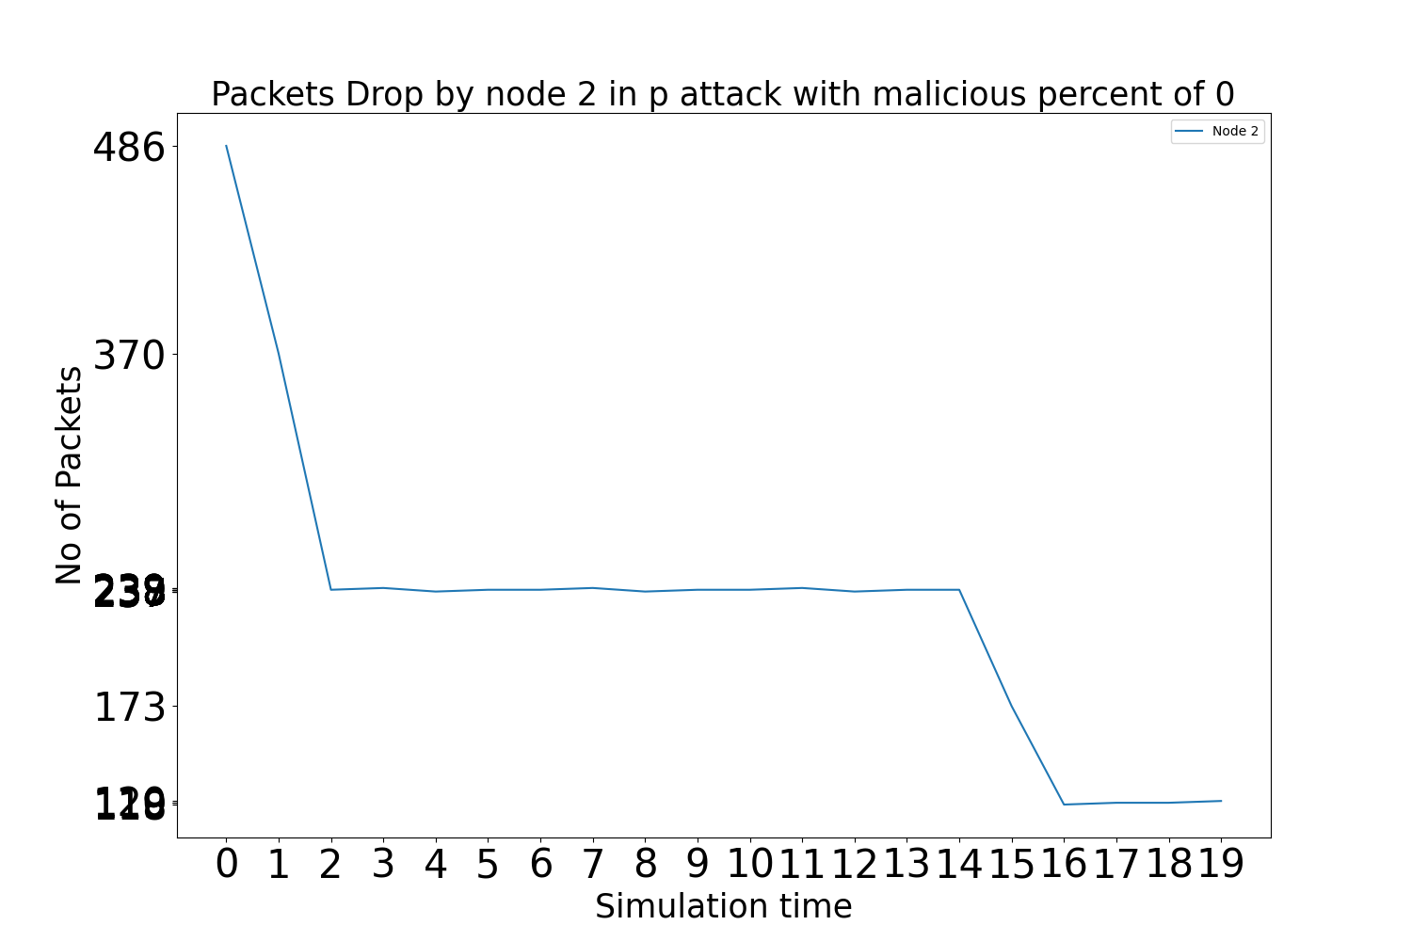
Graphs: Packets Dropped by benign node 2 when there are no attackers in Periodic attack

Slide 33

Graphs: Packets Sent by benign node 2 when there are 2 attackers in Periodic attack

Slide 34
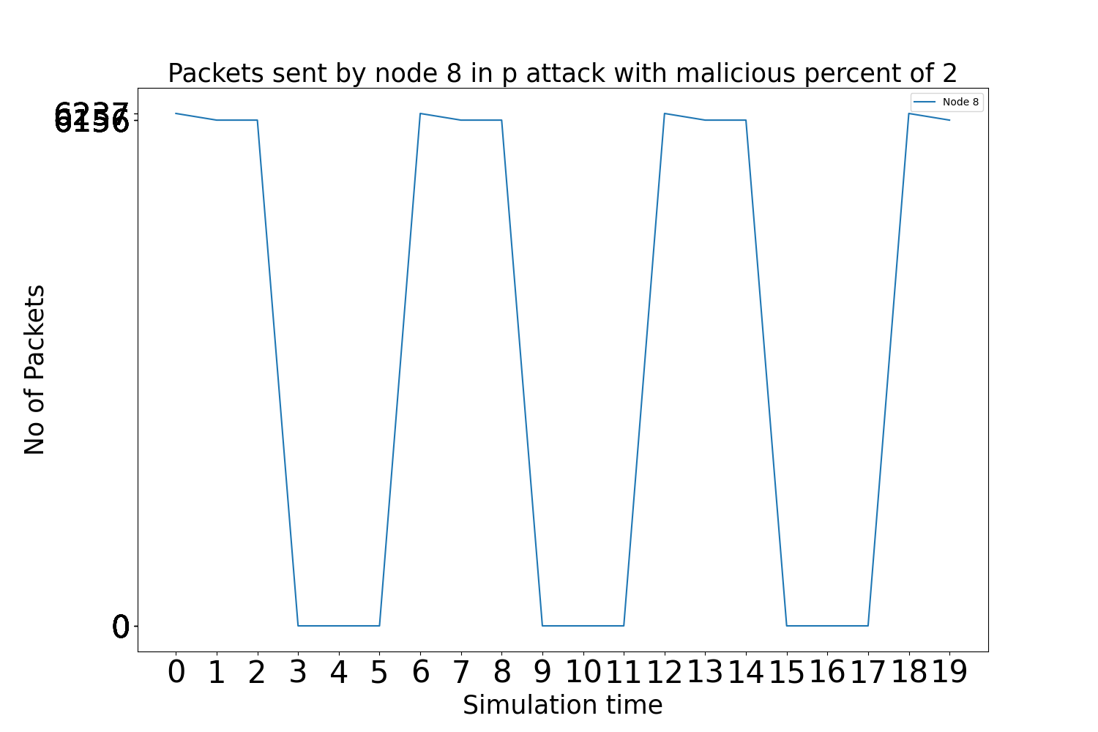
Graphs: Packets Sent by malicious node 8 when there are 2 attackers in Periodic attack

Slide 35
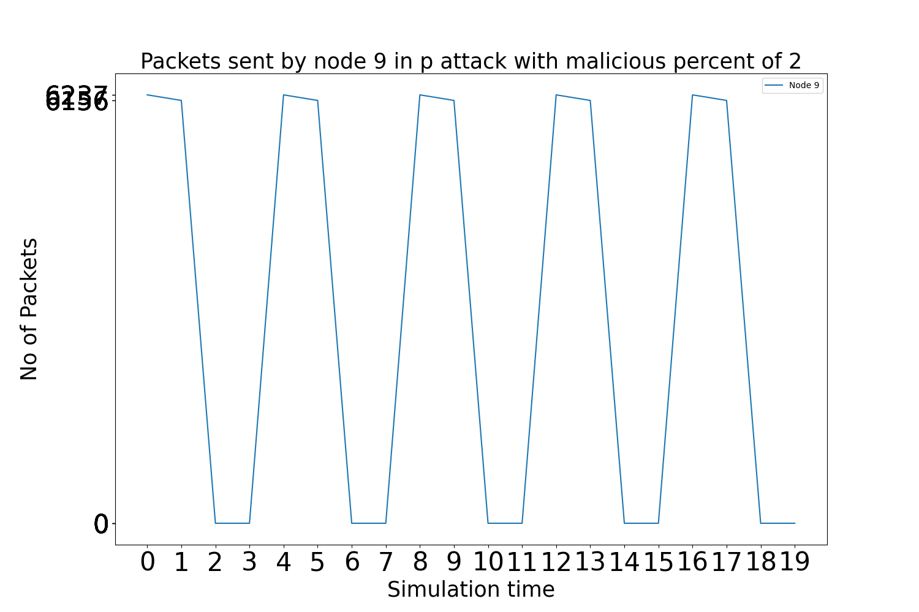
Graphs: Packets Sent by malicious node 9 when there are 2 attackers in Periodic attack

Slide 36
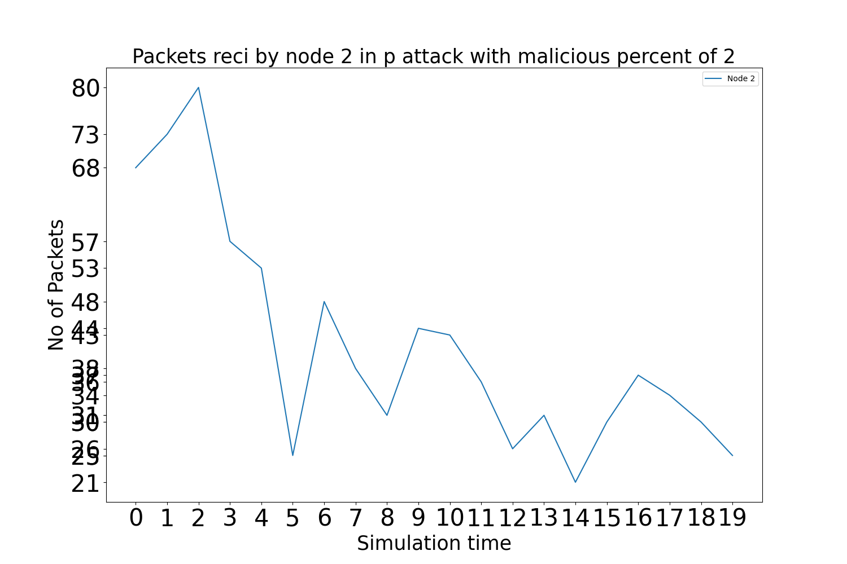
Graphs: Packets Received by benign node 2 when there are 2 attackers in Periodic attack

Slide 37

Graphs: Packets Received by malicious node 8 when there are 2 attackers in Periodic attack

Slide 38

Graphs: Packets Received by malicious node 9 when there are 2 attackers in Periodic attack

Slide 39
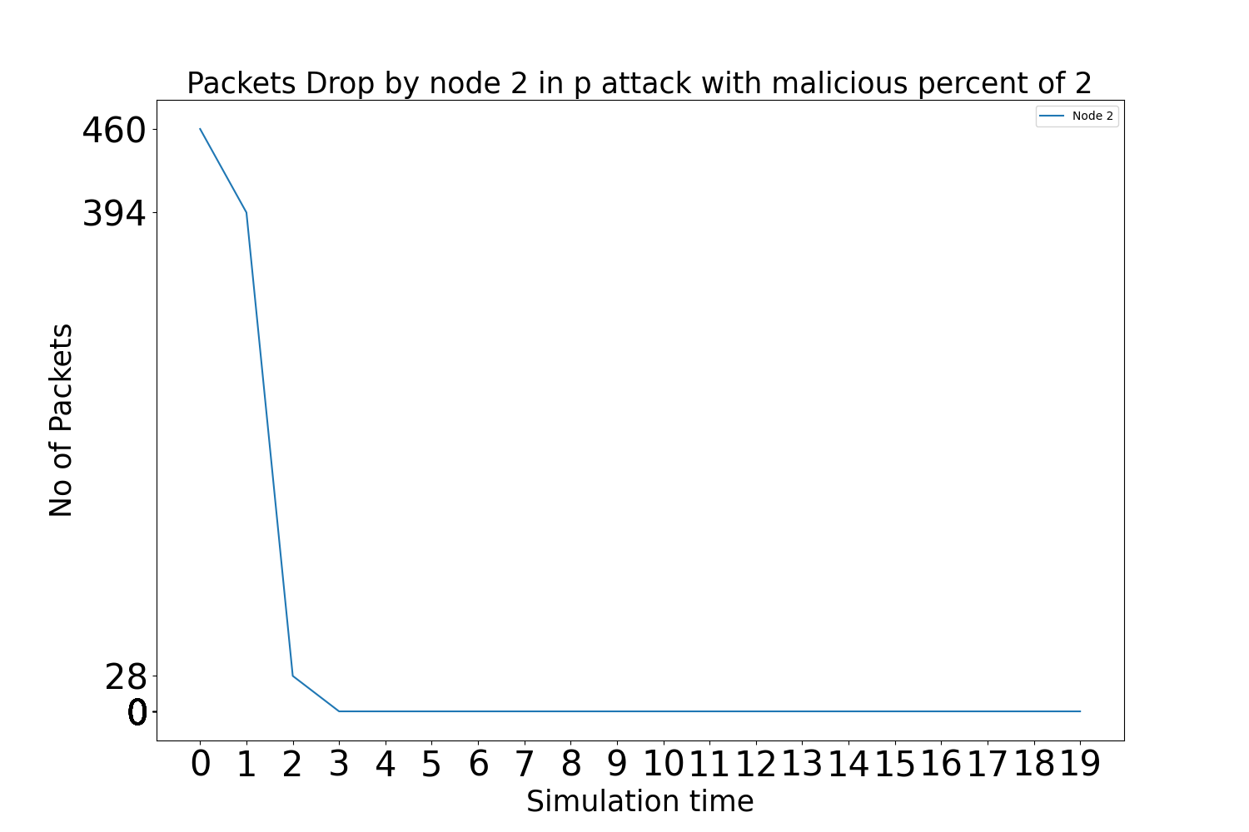
Graphs: Packets Dropped by benign node 2 when there are 2 attackers in Periodic attack

Slide 40
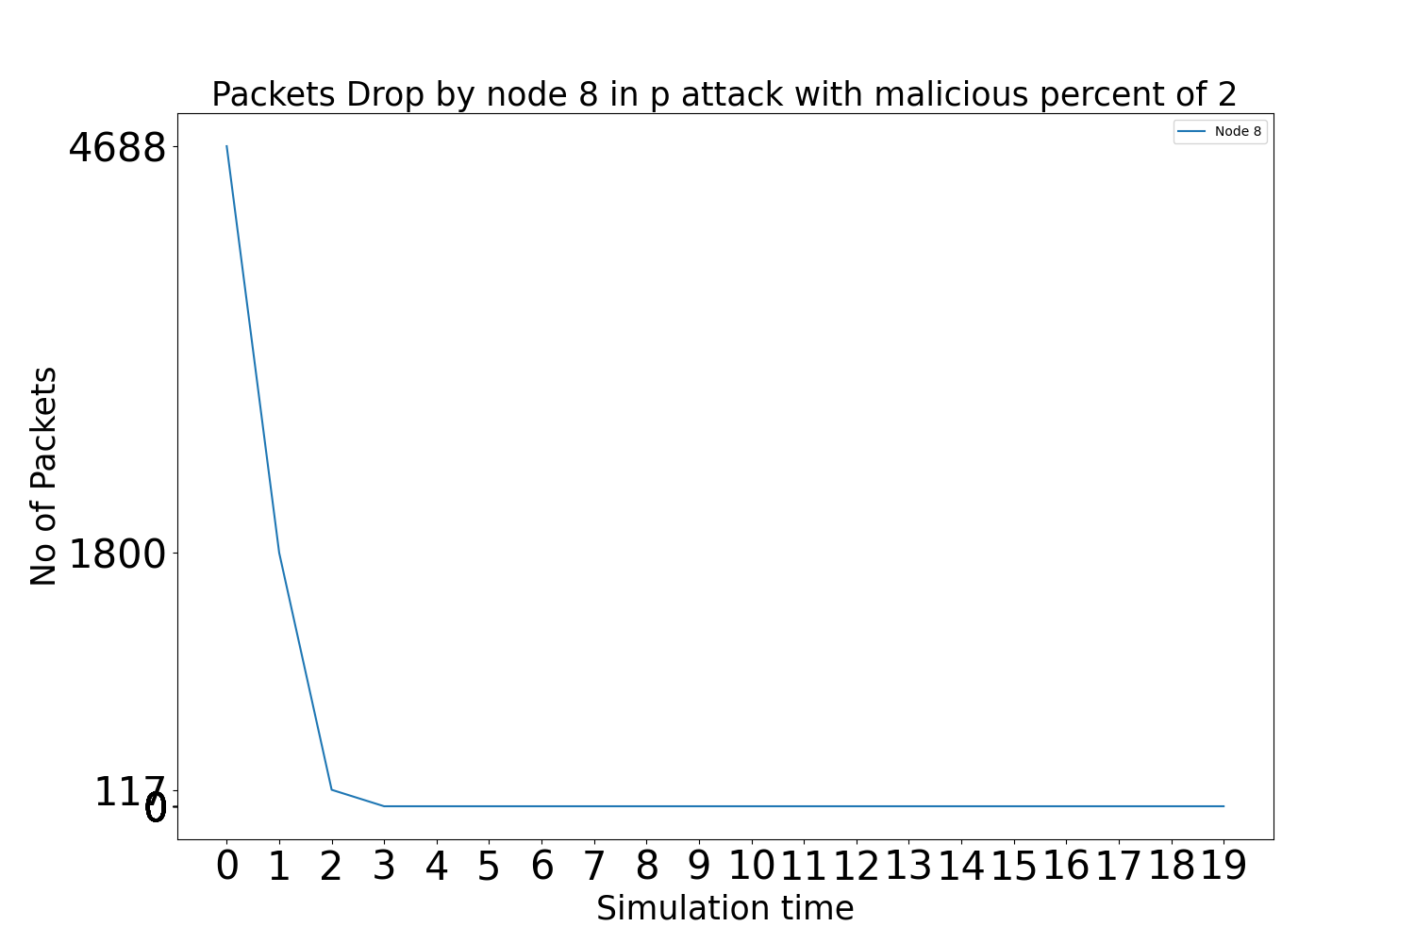
Graphs: Packets Dropped by malicious node 8 when there are 2 attackers in Periodic attack

Slide 41
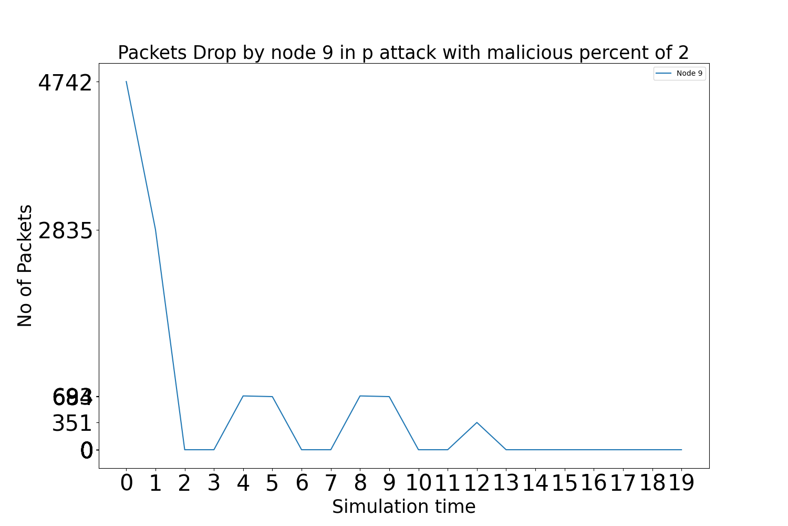
Graphs: Packets Dropped by malicious node 9 when there are 2 attackers in Periodic attack

Slide 42

Graphs: Packets Sent by benign node 2 when there are no attackers in Random attack

Slide 43
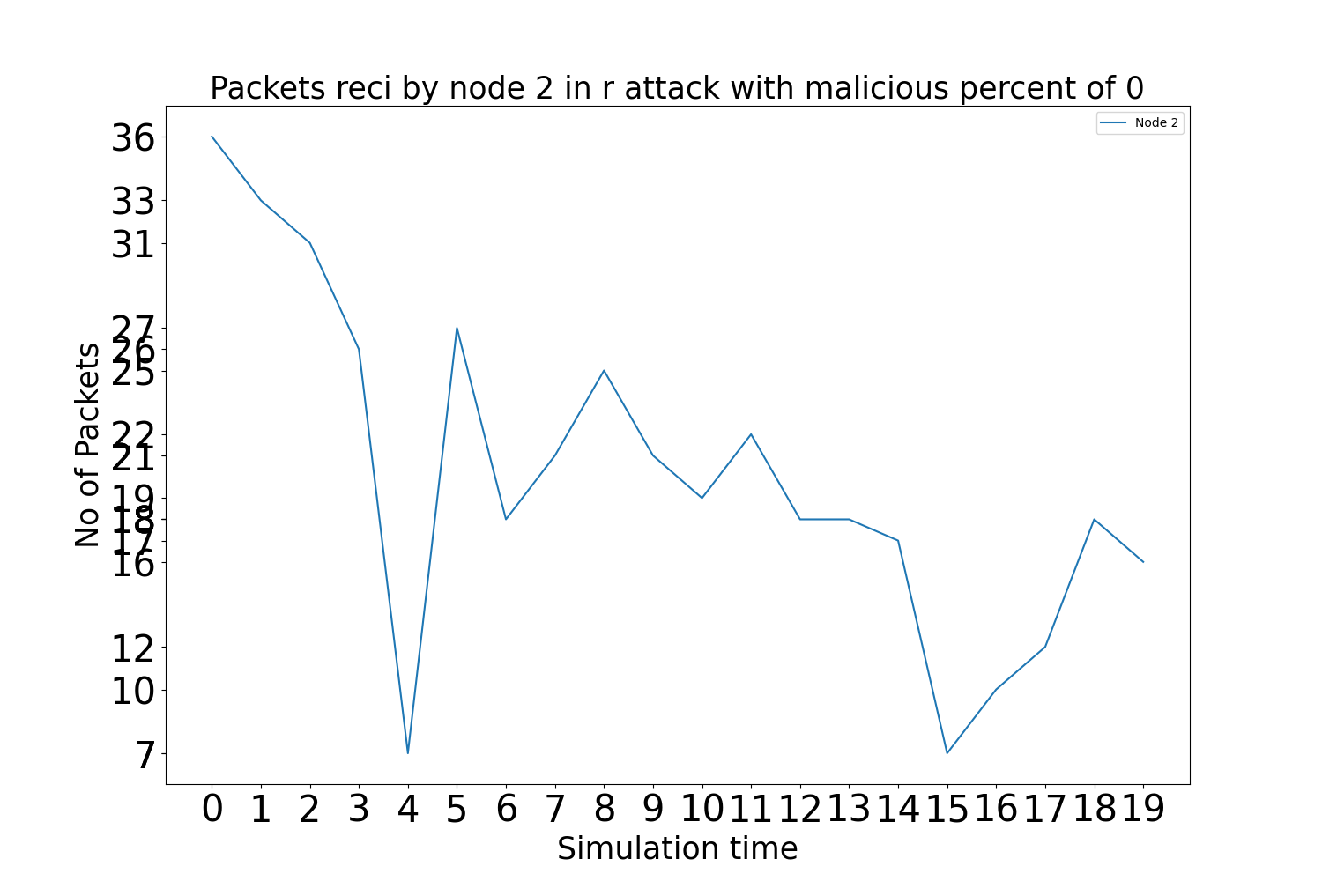
Graphs: Packets Received by benign node 2 when there are no attackers in Random attack

Slide 44
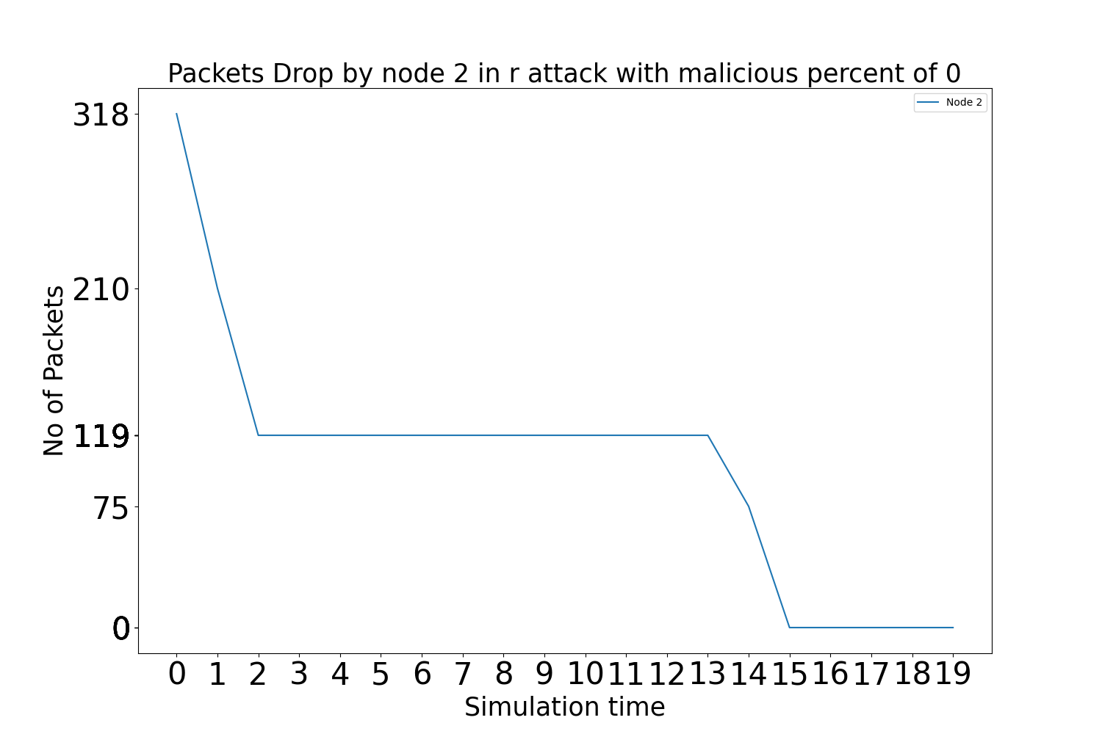
Graphs: Packets Dropped by benign node 2 when there are no attackers in Random attack

Slide 45

Graphs: Packets Sent by benign node 2 when there are 2 attackers in Random attack

Slide 46
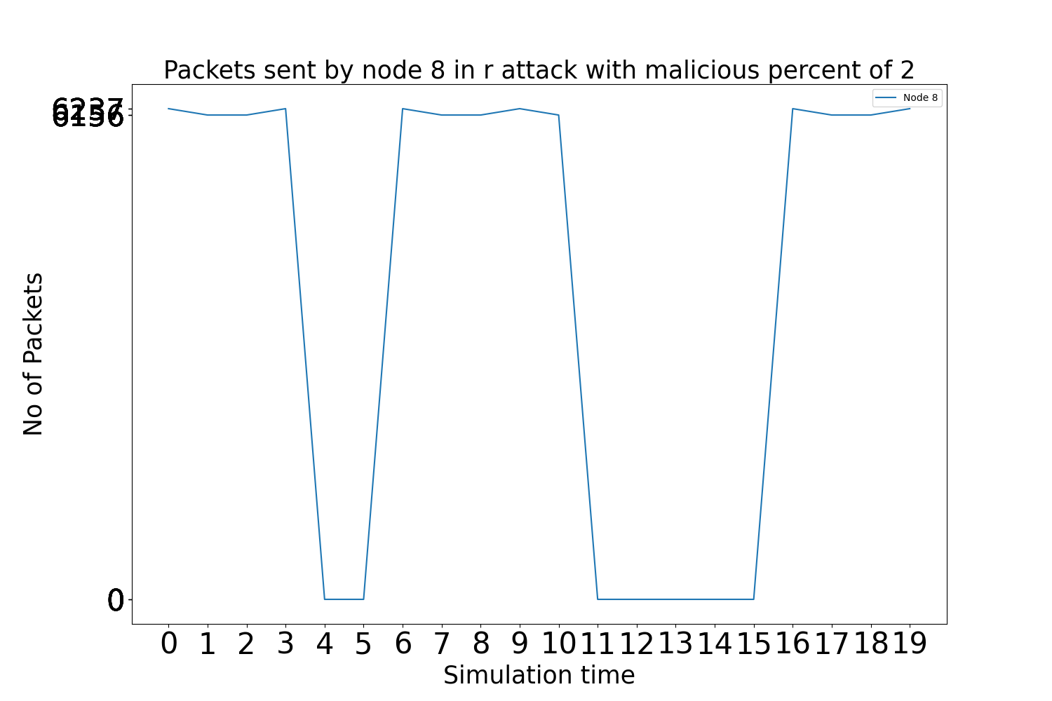
Graphs: Packets Sent by malicious node 8 when there are 2 attackers in Random attack

Slide 47
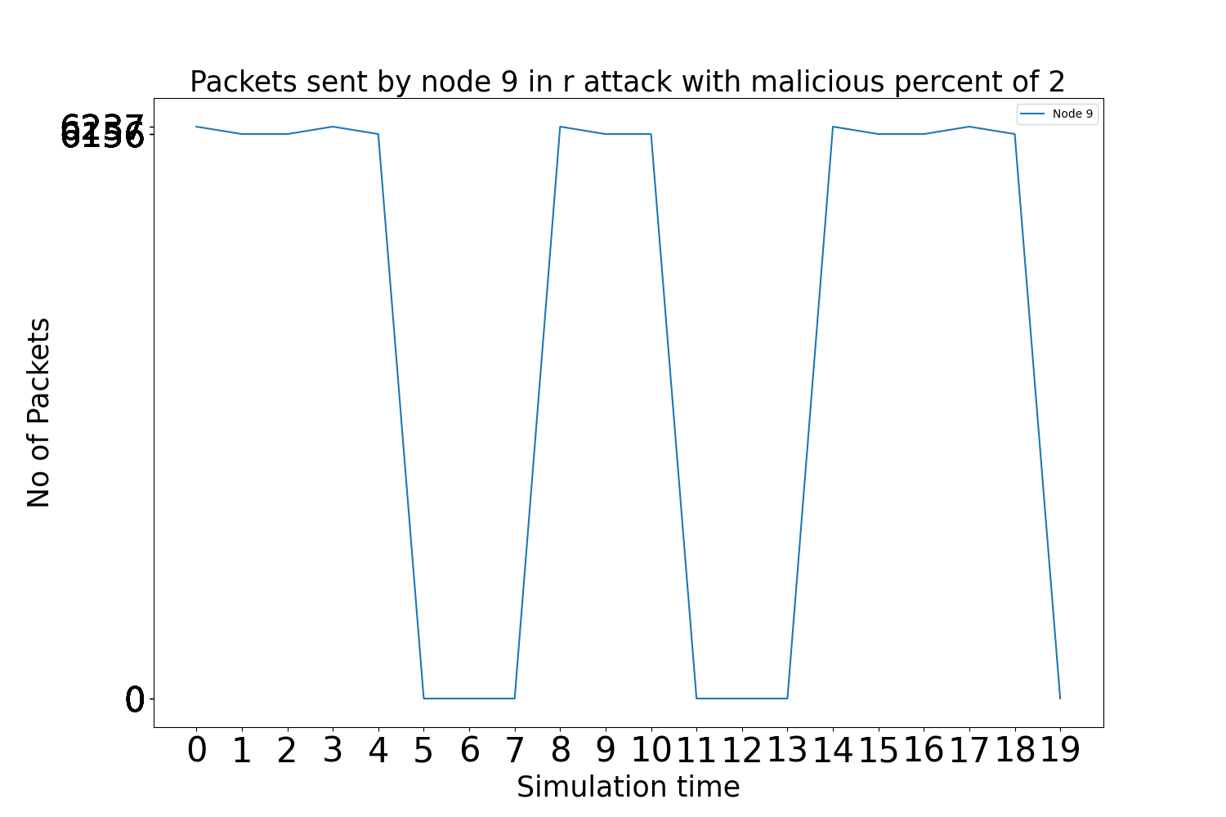
Graphs: Packets Sent by malicious node 9 when there are 2 attackers in Random attack

Slide 48
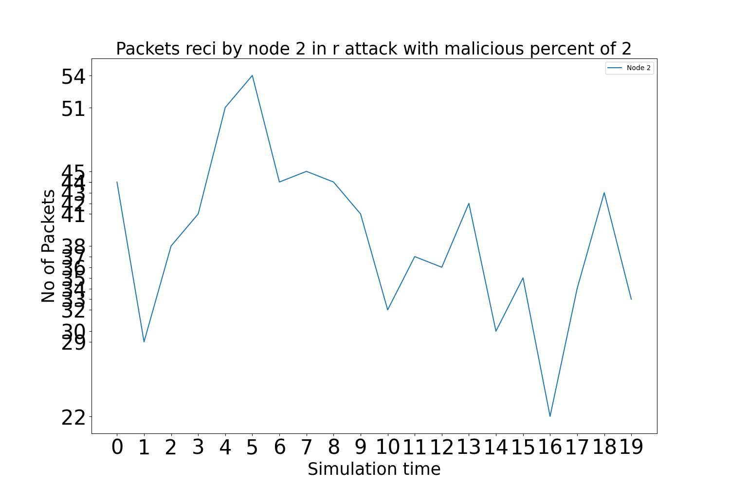
Graphs: Packets Received by benign node 2 when there are 2 attackers in Random attack

Slide 49

Graphs: Packets Received by malicious node 8 when there are 2 attackers in Random attack

Slide 50

Graphs: Packets Received by malicious node 9 when there are 2 attackers in Random attack

Slide 51
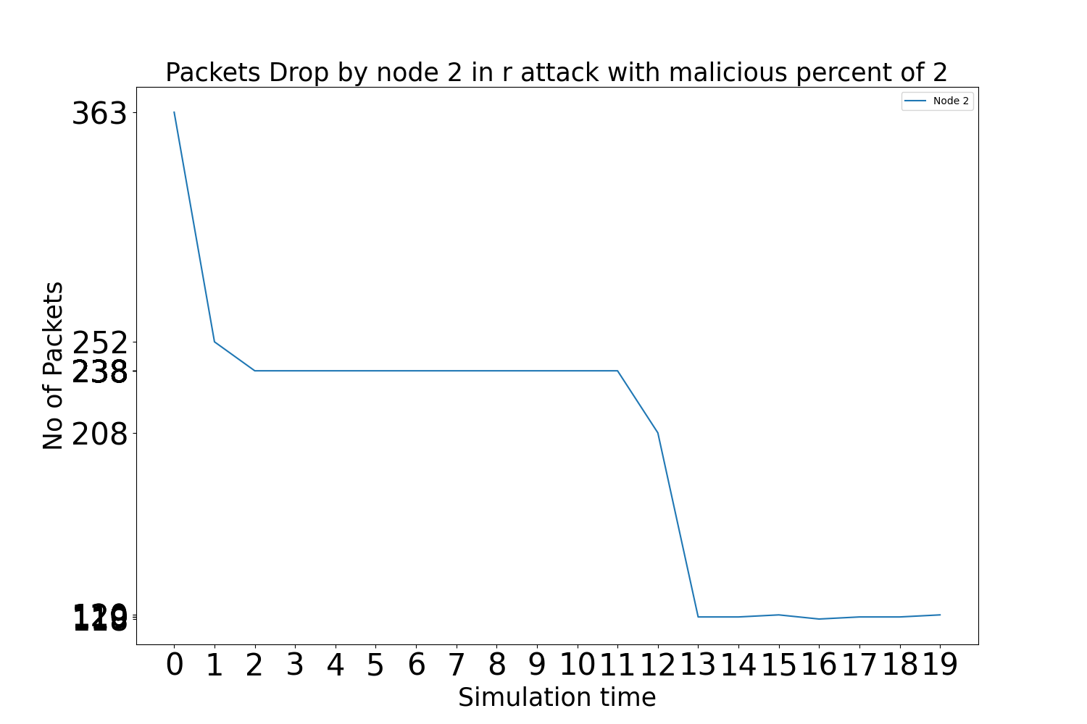
Graphs: Packets Dropped by benign node 2 when there are 2 attackers in Random attack

Slide 52
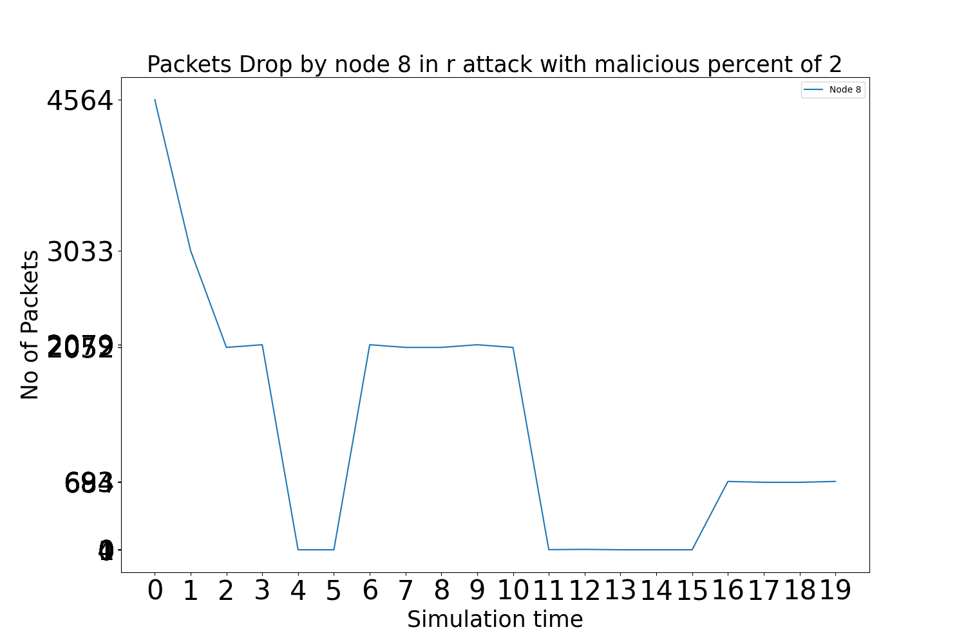
Graphs: Packets Dropped by malicious node 8 when there are 2 attackers in Random attack

Slide 53
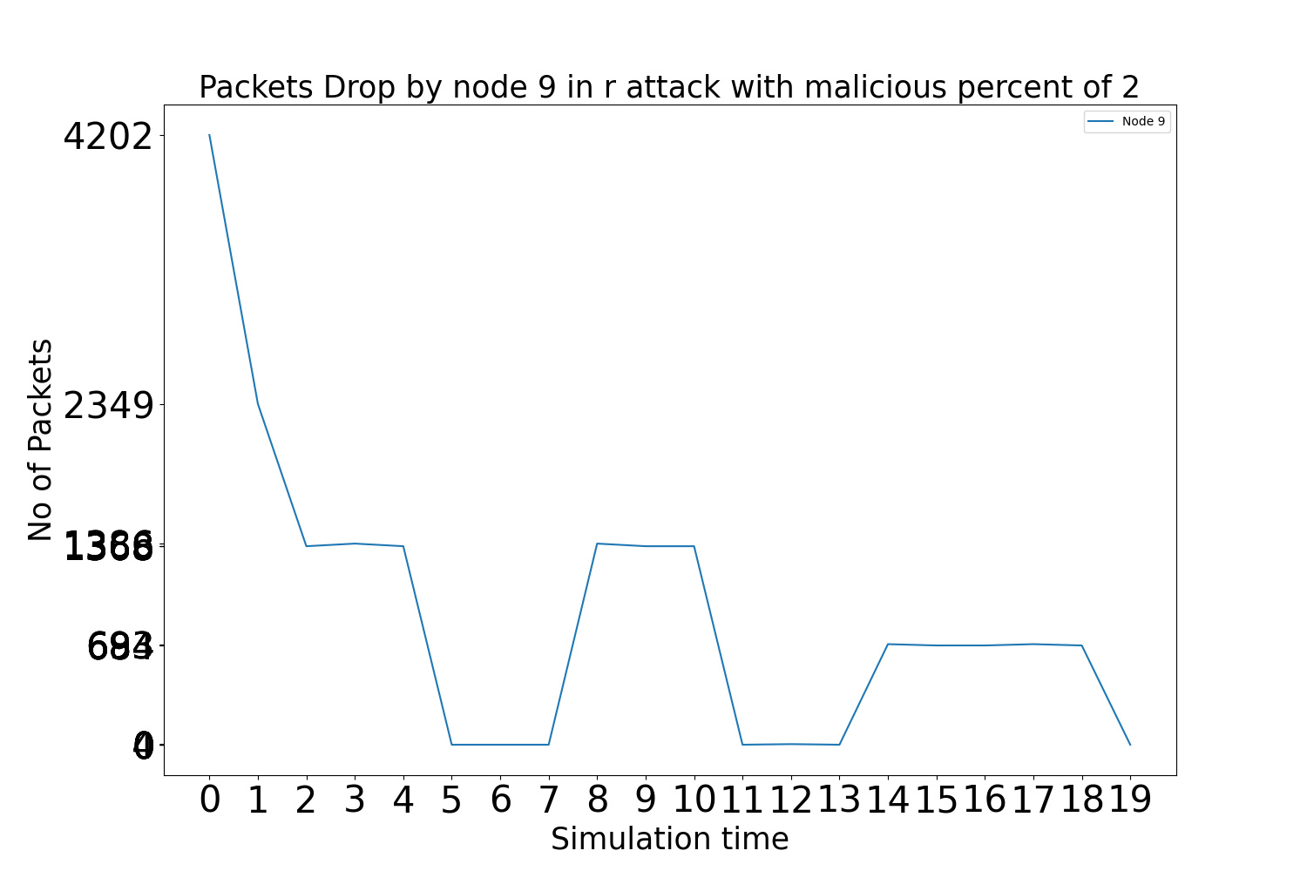
Graphs: Packets Dropped by malicious node 9 when there are 2 attackers in Random attack

Slide 54
Conclusion
The paper presented the detection mechanism to detect various jamming attack nodes in MANET. The network is created and simulated in NS2 tool with 10 nodes out of which all the nodes are behaving like normal nodes at one time later some of the nodes shows normal behavior and other nodes shows different jamming behavior like constant, periodic and random jammers varying from single attack node to multiple attack nodes. Then the like packet sent, received and dropped collected from trace file and analyzed using python scripts, from these characteristics the packets delivery ratio and packet drop ratio calculated and based on this behavior the malicious node was detected by this the network performance can be unproved by re-routing the network.

Slide 55
Future Scope
In future,
The behavioral analysis of jamming nodes can also be classified using Machine Learning Algorithms.
Not only characteristics like number of packets sent, number of packets received and number of packets dropped there are many more characteristics for classifying the malicious nodes from normal nodes.
In this project all the malicious nodes and the normal nodes start at 0th second this can be modified as malicious nodes starting from a particular second like 5th or 10th or any such. This helps while comparing the characteristics of normal network to a network with malicious nodes.

Slide 56

Any Queries

Slide 57

Thank You

